Slide 1


Development Regulations Update
Comprehensive Plan, Land Use Map, Zoning Ordinance

Slide 2
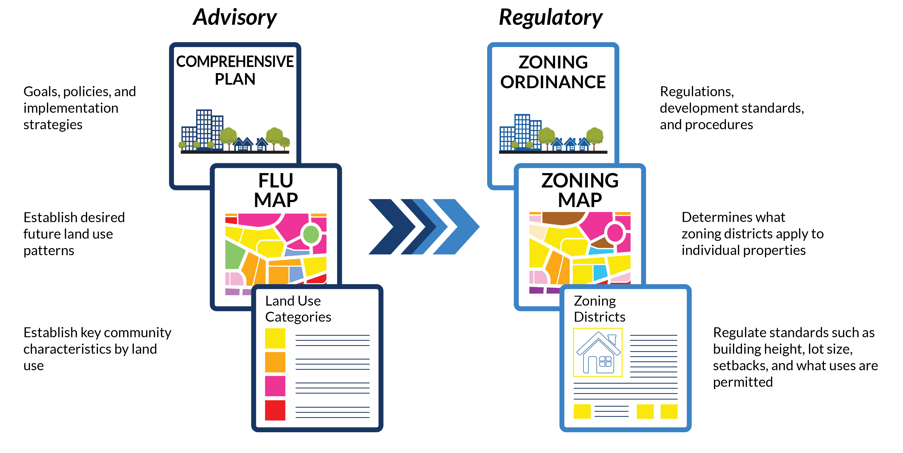
Purpose
Planning and Regulation:
Comp plan establishes broad land development goals
Future Land Use (FLU) Map assigns the highest-and-best use Land Use Categories spatially throughout the county.
Zoning Ordinance regulates development based on the goals of the Comp Plan
Zoning map spatially assigns zoning categories that are consistent with Land Use Categories
FLU Map and Categories guide proactive or reactive zoning
1

Slide 3
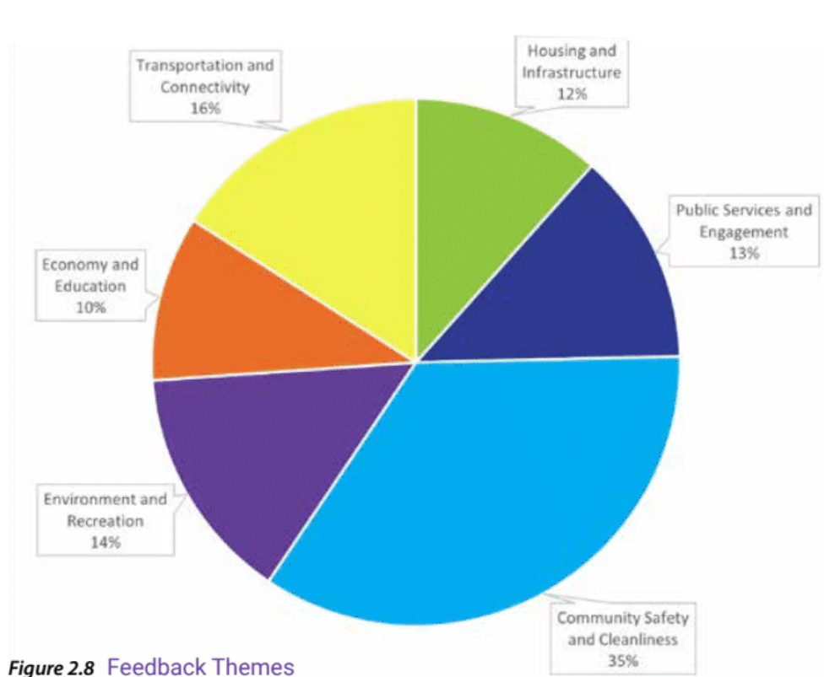

Comprehensive Plan Basis
Public Involvement
Online surveys
Design charettes
Stakeholder engagement
Administrative staff input
Case history
County history
National trends and best practices
Socioeconomic and environmental factors
Windshield surveys
Existing municipal and regional plans
2

Slide 4
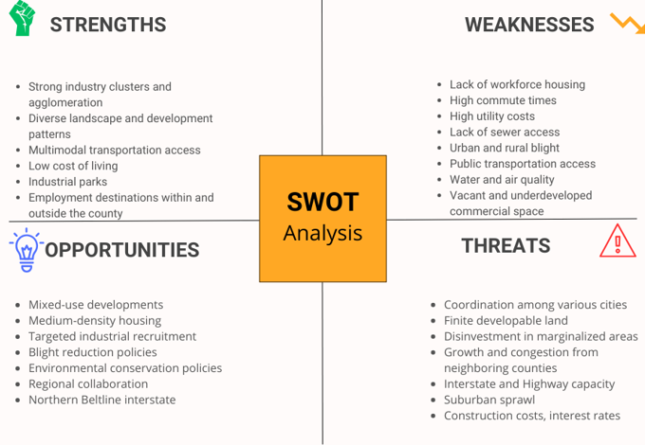
1

Slide 5
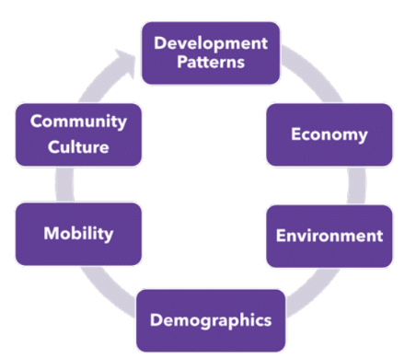
Strategic Goals
Development of Activity Centers
Economic Development
Workforce housing
Natural, recreational, & farmland conservation
Improved transportation mobility
4

Slide 6
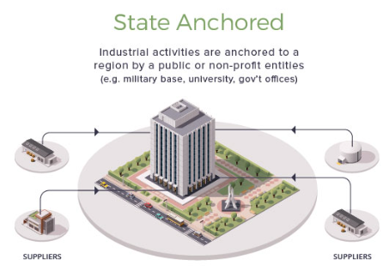
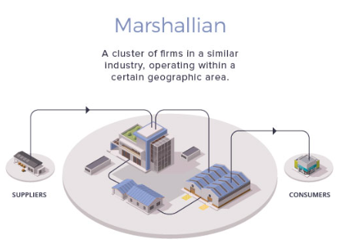
Economic Development
Increase industrial land inventory
Support industrial parks with infrastructure expansion and supportive land uses
Leverage Birmingport
Designate strategic sites as employment centers in disinvested communities
Mitigate blight
Cluster supportive industries around UAB West.
Improve transportation
5

Slide 7
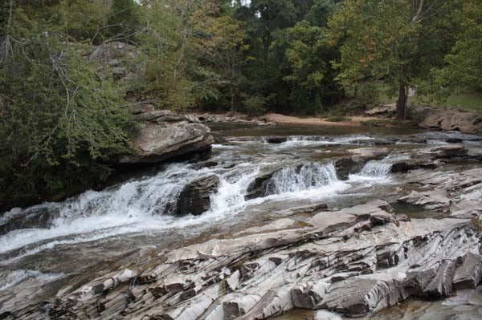
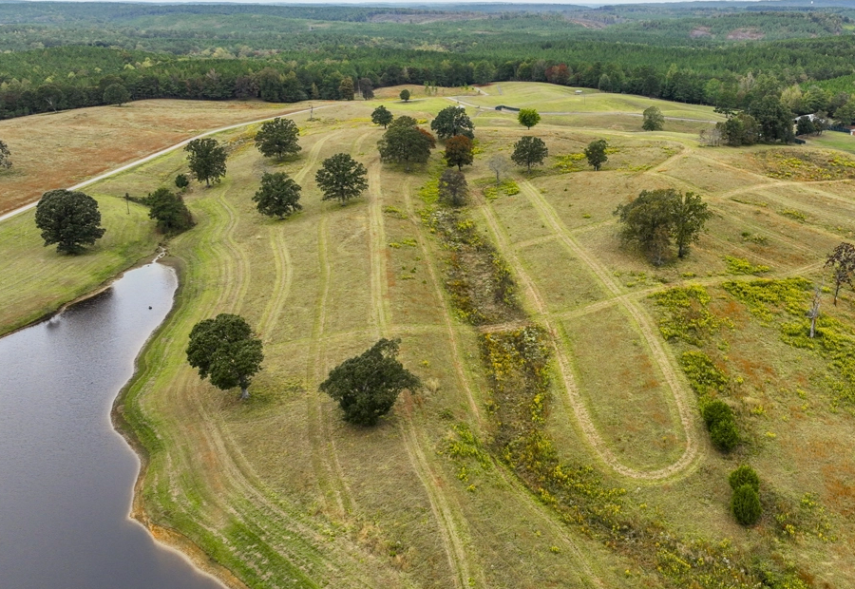
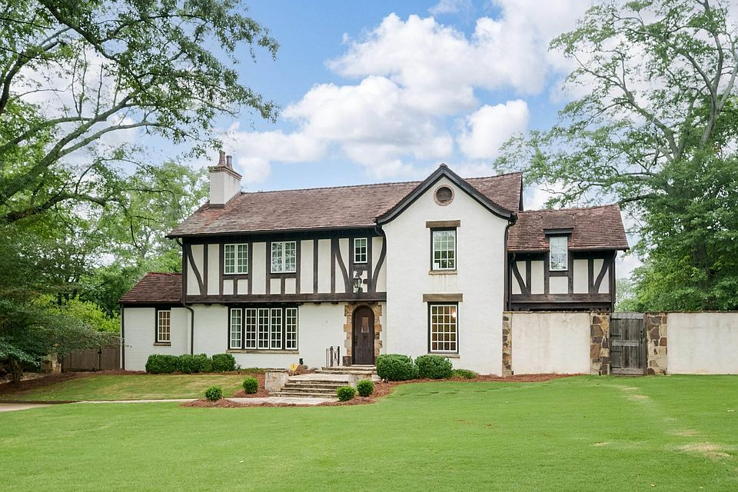
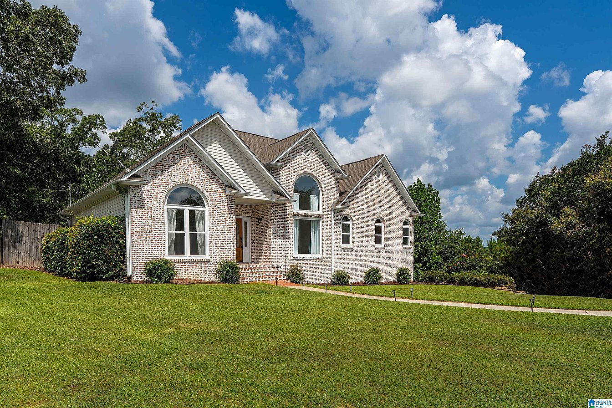
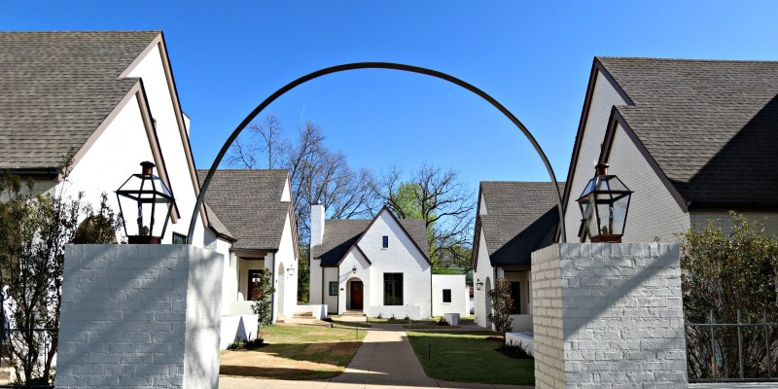
Natural Area
Rural
Estate
Suburban
Mixed-Res.
6

Slide 8
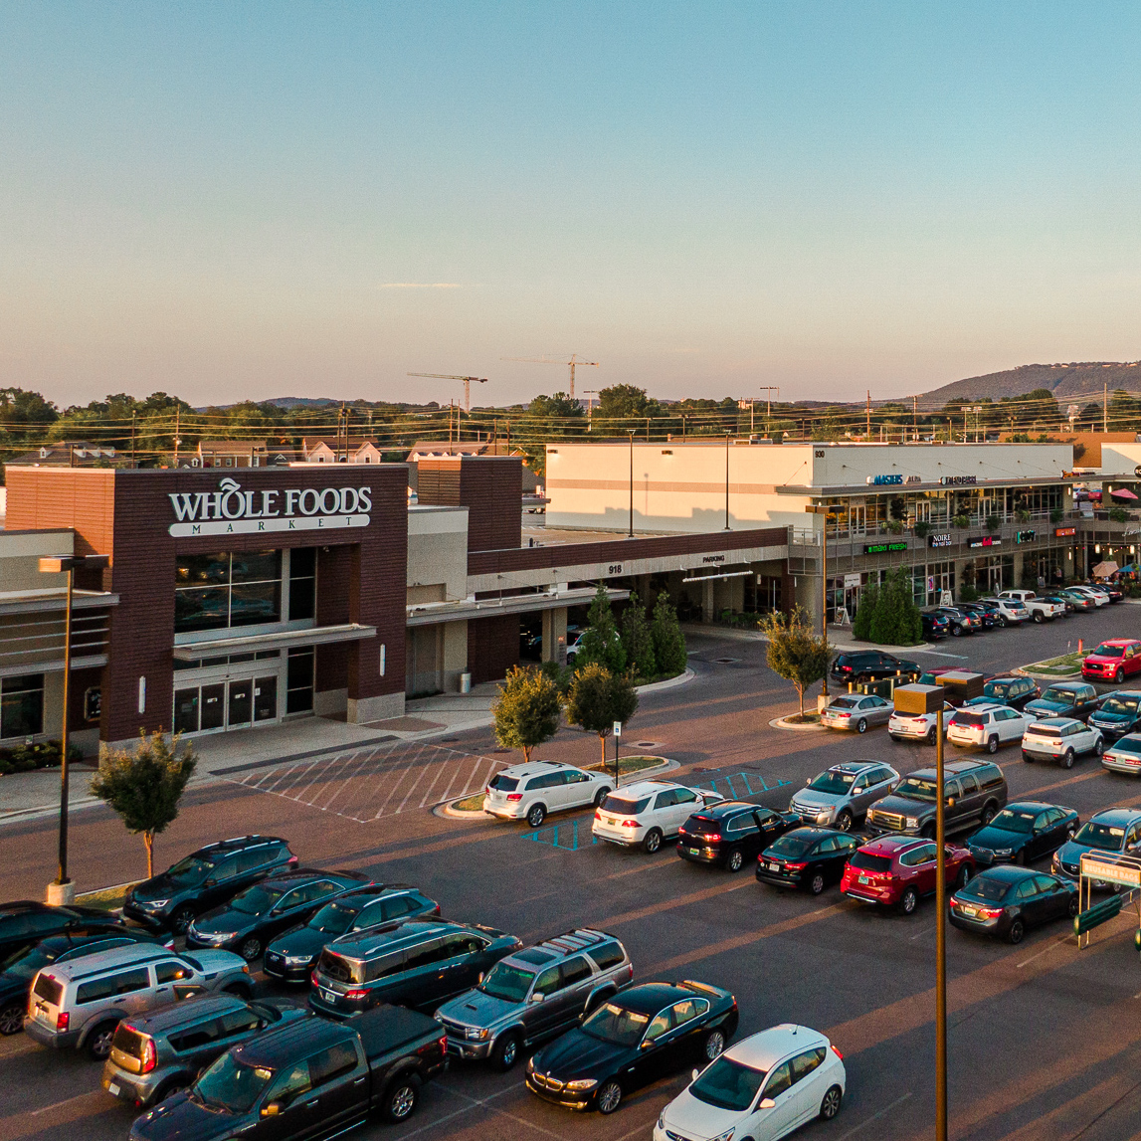
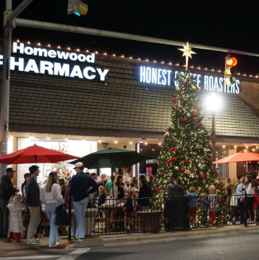
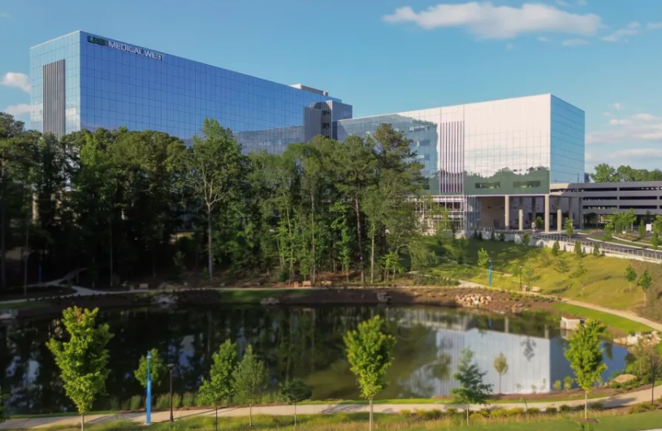
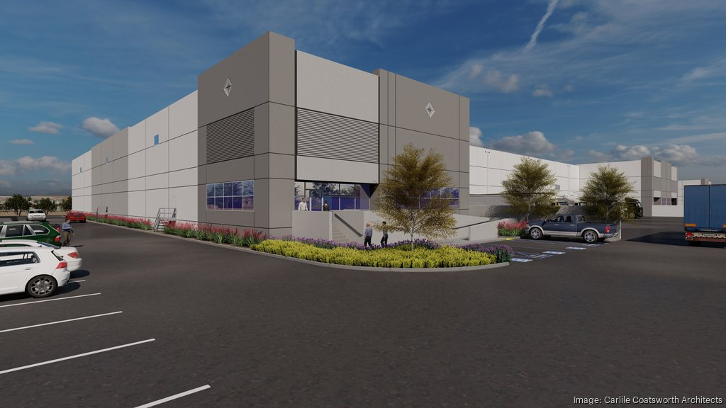
Commercial Corridor
Neighborhood Center
Activity Center
Employment Center
7

Slide 9
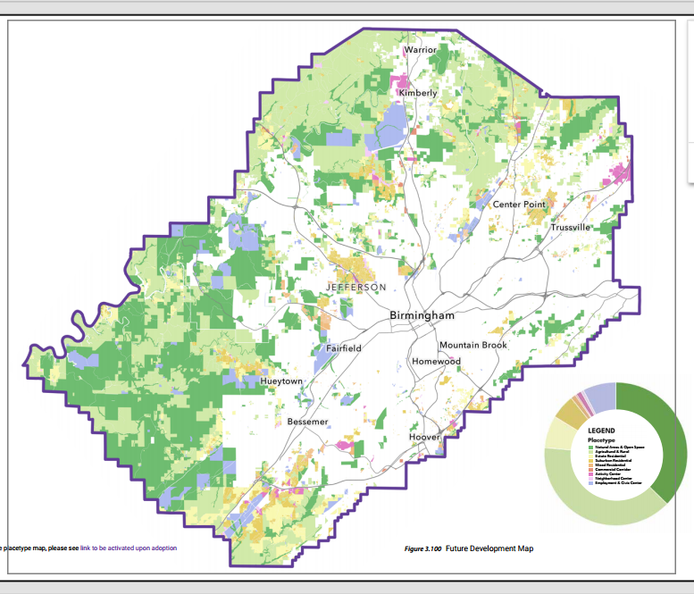

Slide 10
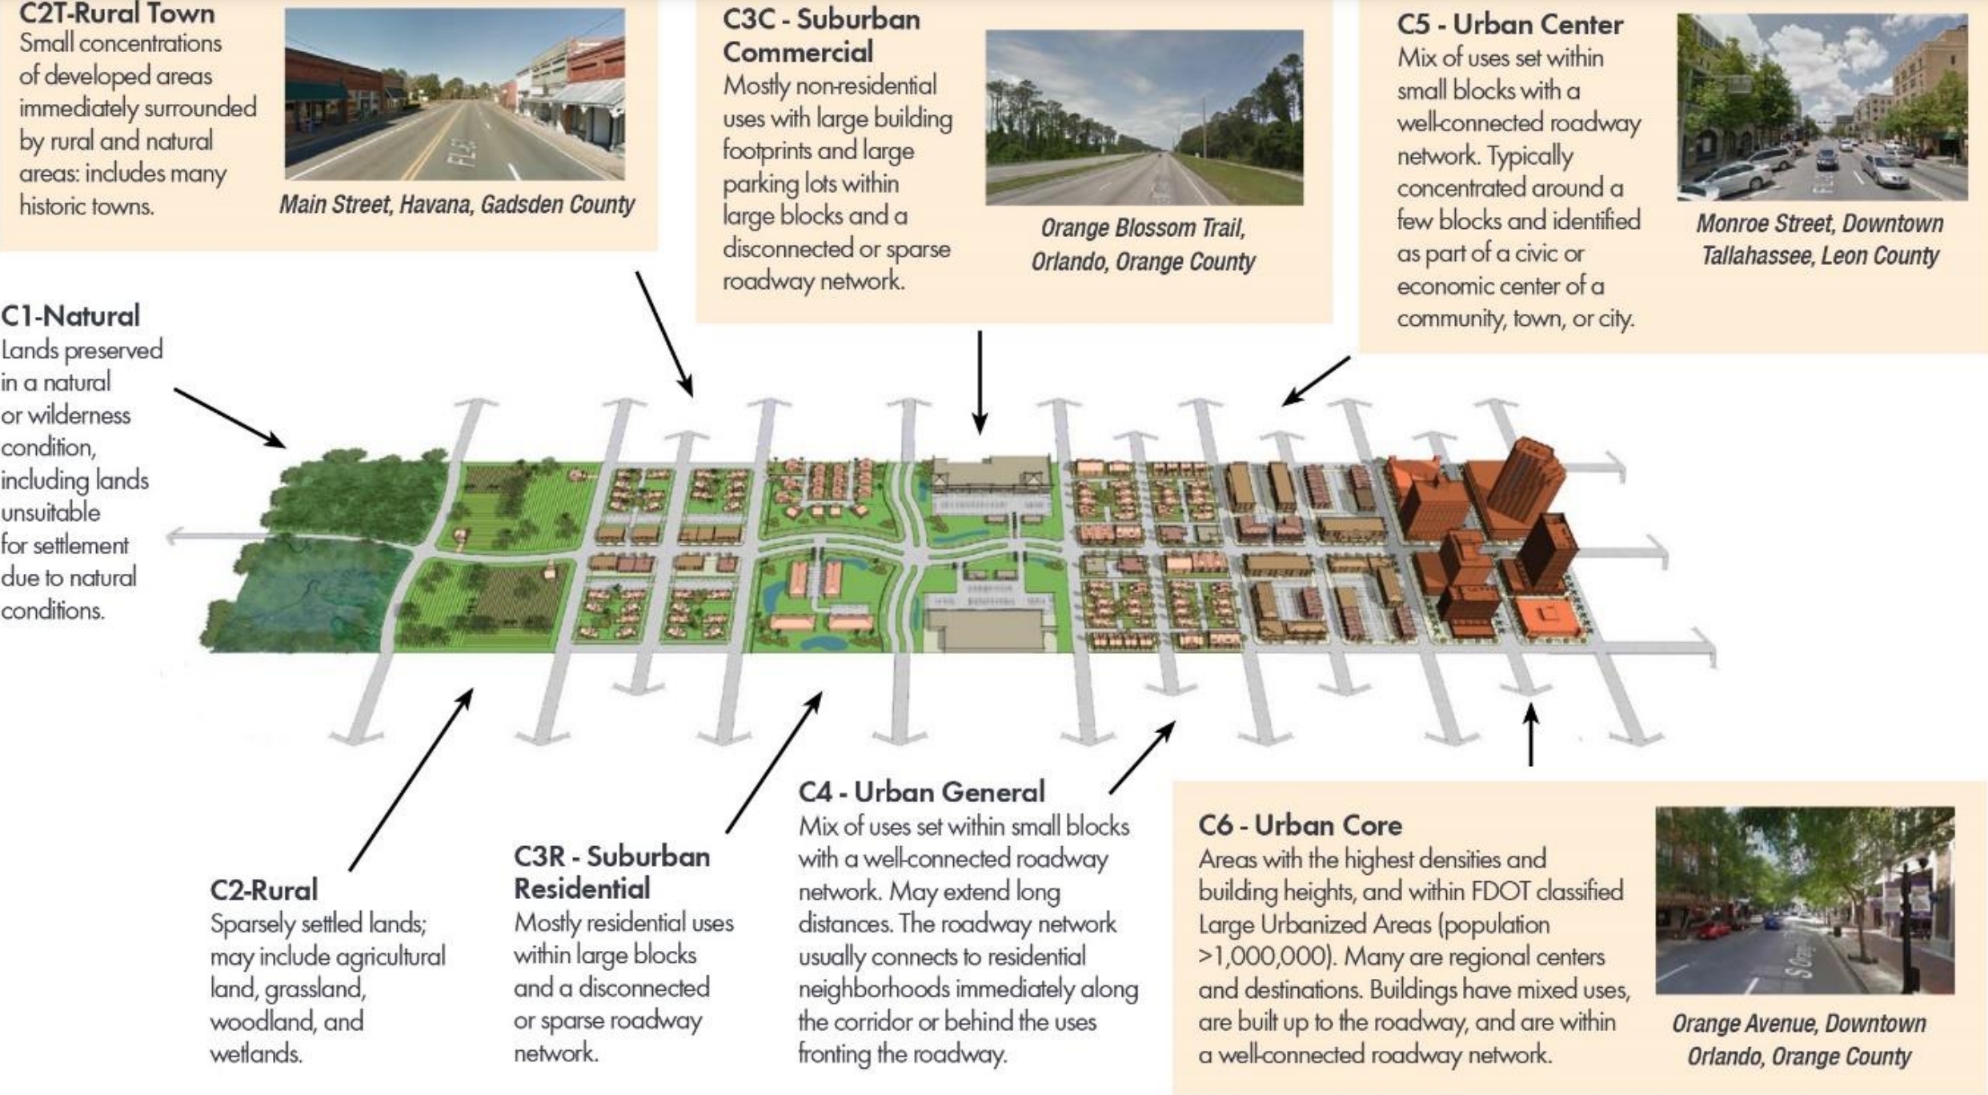

Slide 11
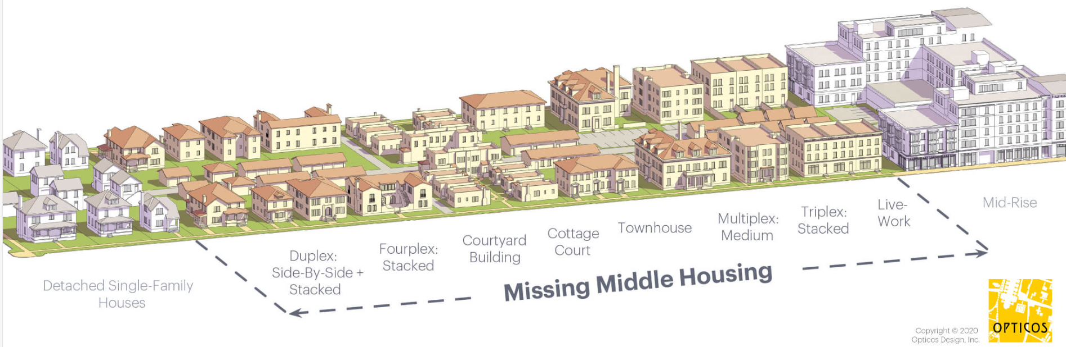
Workforce Housing
Allow Accessory Dwelling Units (ADUs)/'granny flats' for immediate family
Increased design standards with increased density
Permit increased senior housing, luxury, and estate housing to free up existing inventory
Limit suburban sprawl by focusing residential development on large-lot estate and medium density
Allow medium-density residential near major employment and transportation and employment assets
7

Slide 12
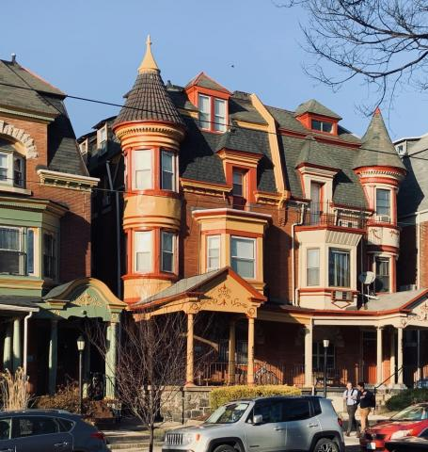
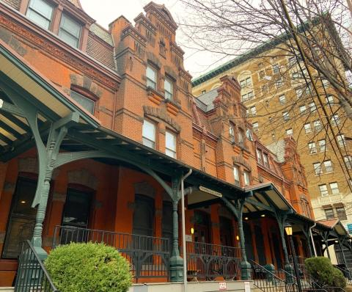
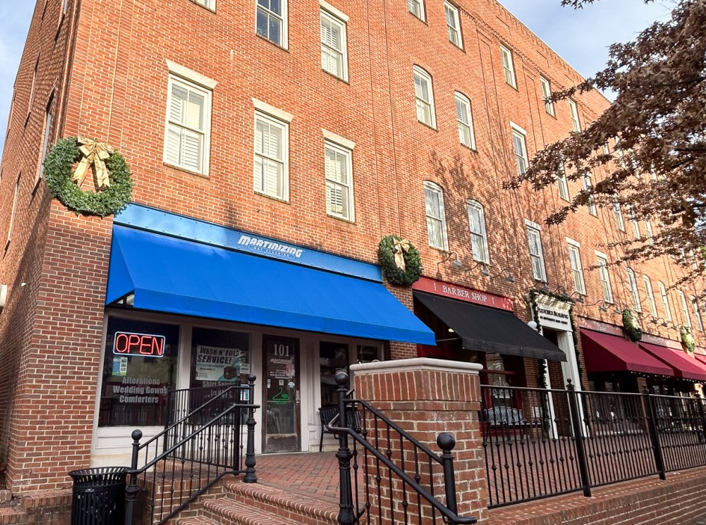
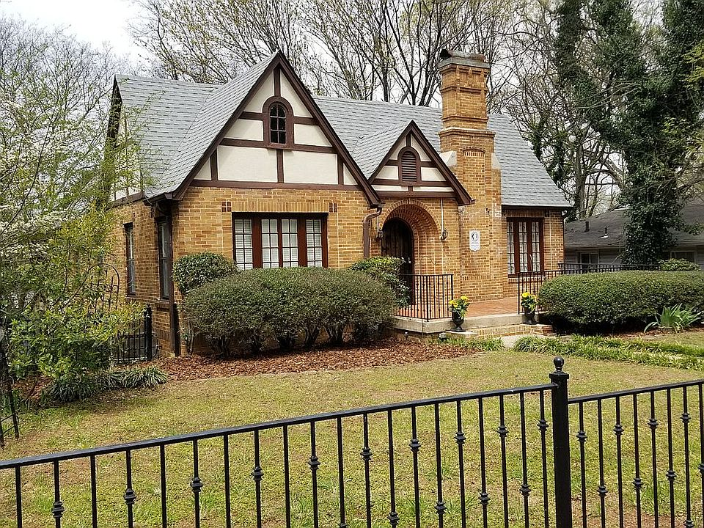
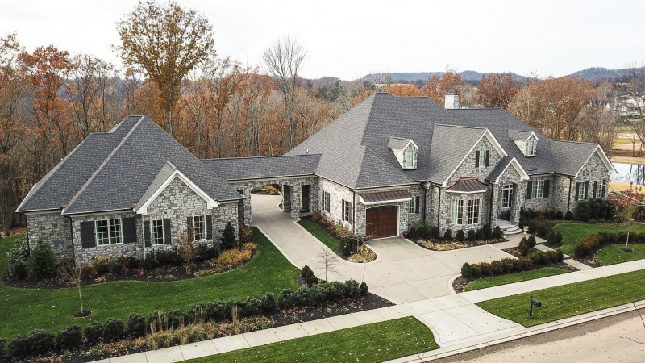
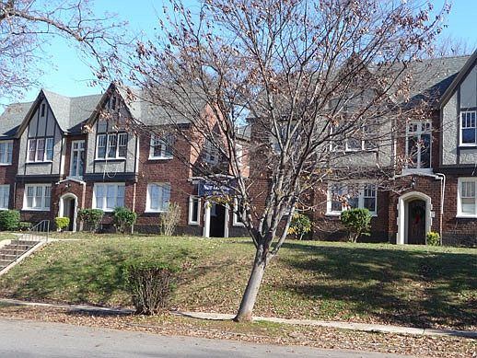
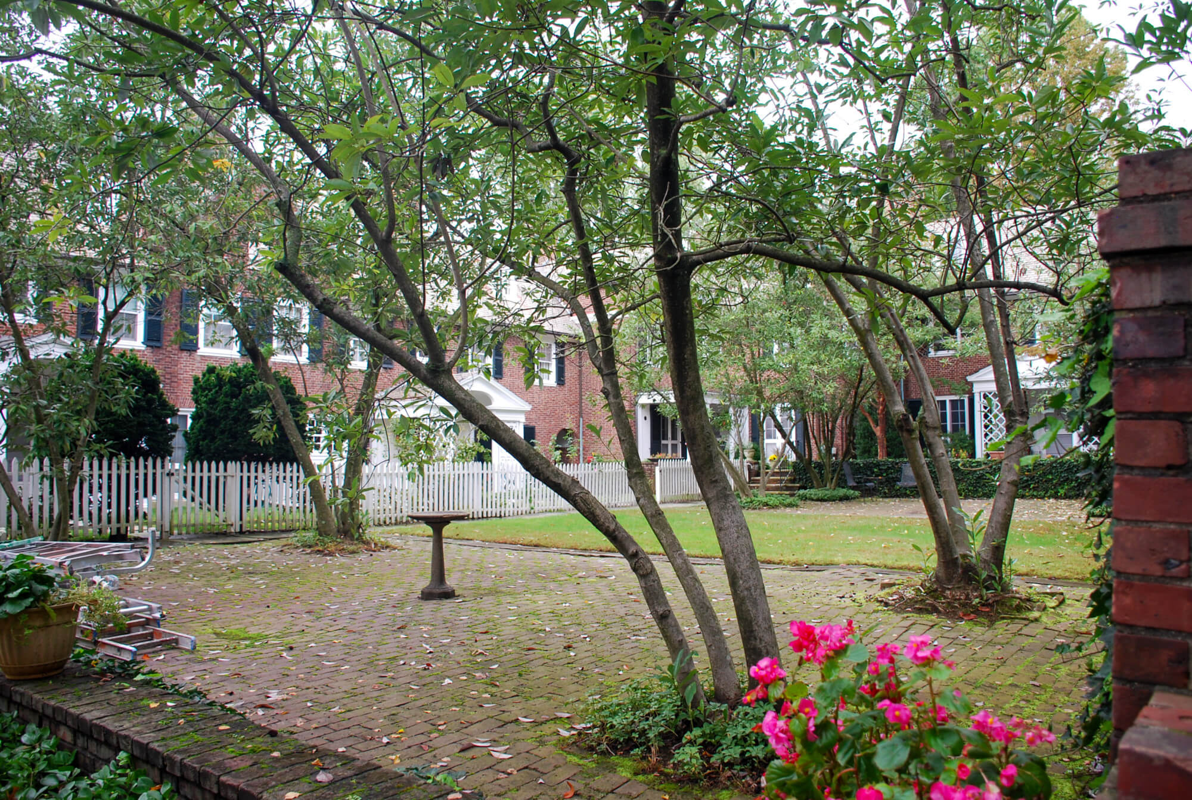
Estate 3
Estate 4
Live-work
Cottage
Multiplex
Bldg. Courtyard
ADU
Cottage Court
13

Slide 13
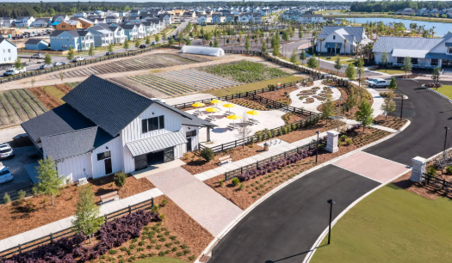

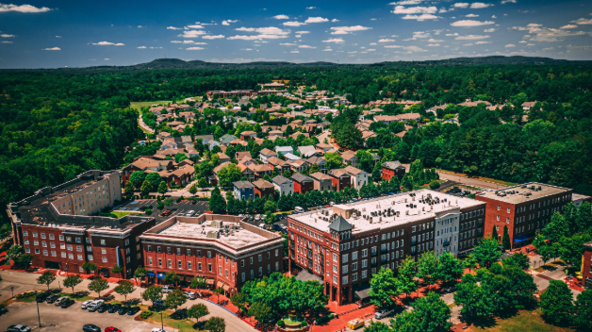
Conservation District
Village District
Town Center District
14

Slide 14
Zoning Ordinance Highlights
Increased design with increased density
Single-family detached housing, typical lot width is 65'
Mixed-use
Medical cluster district around UAB West
Farming protection zoning
Tiny Homes
Overlay protection for sensitive environmental features
N. Beltline overlay to maximize infrastructure
Life-safety provisions, e.g., storm and fire protection
Administrative revisions based on Variance case history
Administrative Reviews:
  Traffic Impact Analysis
  Economic Impact Analysis required Industrial requests
  Private Sewer management provisions
15

